Slide 1
SAP HANA on Azure

Slide 2
Abstract and learning objectives
Abstract
In this workshop, you will look at what is involved in deploying SAP HANA on Azure with the goals of designing for high availability, disaster recovery as well as supportability.
At the end of this workshop, you will be able to better design and deploy SAP HANA on Azure.
Learning objectives
Design high availability for SAP HANA workloads on Azure VMs
Design disaster recovery for SAP HANA workloads on Azure VMs

Slide 3
Step 1: Review the customer case study
Outcome
Analyze your customer needs.
Timeframe
15 minutes

Slide 4
Customer situation
Contoso Group
Contoso Group is a global pharmaceutical company with its headquarters based in Boston, US.
Contoso has been using SAP ERP and BW on HANA for its Finance/Logistics/Analytics systems on the HP-UX/Oracle platform.
Contoso Leadership and Planning Groups wants to drastically reduce server and storage hardware in their own datacenters to minimize IT related costs. Contoso has already a number of their non-SAP systems migrated to Azure. The leadership asked Contoso IT to look into the possibility of migrating its SAP HANA environment to cloud.
Contoso IT decided to leverage its knowledge of the Microsoft cloud platform and existing ExpressRoute connectivity and host its SAP landscape in Azure. The intention is to migrate the BW system first (go live in March CY18) and migrate ECC in Q4 of CY18. The multi-stage approach is supposed to minimize potential migration risks.
Considering that Contoso management team often uses BW to support their management decisions, the systems should be highly available, and their performance must be predictable and consistent. In addition, the management team wants to leverage disaster recovery capabilities offered by Azure in order to ensure resiliency of the migrated environment in case the primary region hosting the new deployment becomes unavailable.
Before migrating the production environment, Contoso wants to test its new deployment approach by provisioning training, development, test, and UAT environments in Azure.

Slide 5
Customer situation
“Our operational dependencies on SAP applications force us to seek reasonably priced availability and disaster recovery capabilities for our production SAP HANA deployments.”
Andrew Cross, CIO, Contoso Group

Slide 6
Customer needs
Highly responsive systems with low network latency
In-memory database performance
High availability & disaster recovery
Enterprise data protection & security
Safe migration with downtime minimized
Access from HANA-based applications
Minimized cost

Slide 7
Customer needs (1/4)
Scope : SAP BW migration to HANA in Azure VMs
Go-live date : March 2019
Current BW (ABAP Unicode) on-premises with HP-UX/Oracle and application layer on Linux
ERP is kept on-premises (with HP-UX/Oracle) until December 2019
Data is transferred from ERP (on-premises) to BW (in Cloud) every hour
Customer requests flexible VM solution within Cloud to accommodate the BW workloads.
Use 1-year Reserved VM Instance option for Production VMs
(Option) Need to start to prepare for ERP migration to Cloud

Slide 8
Customer needs (2/4)
Sizing
Production (3-tier) with latest OS/DB fully certified and supported by SAP
HANA sizing memory requirement 1.2 TB, estimate 1.9 TB in 3 years
Throughput DB files at least 400MB/s [/hana/data]
Throughput DB Log files at least 250MB/s [/hana/log]
BW application servers: 15K SAPS
Certification is NOT required for non-Prod
QA (2-tier) HANA database server: 800 GB
Dev, Test (both 2-tier) HANA database server(s): 256 GB
Uptime – Prod: 24x7, 744 hrs/m, QA - 50 hrs/m, DEV/Test - 200 hrs/m

Slide 9
Customer needs (3/4)
Availability and Backup
Both HA and Non-HA options need to be proposed
With HA option, in case of server/storage issues, auto failover to complete within a few minutes, in case of a disaster recovery within 1 day
Long term backup – use reasonable backup storage in Cloud
Data loss not allowed
HANA DB log backup taken every 30 minutes
DB log backup to be kept for 1 day (DB restore to be fast)
HANA DB full backup every night
Daily HANA DB full backup to be retained for 1 month
Monthly HANA DB full backup for 1 year, annual for 3 years

Slide 10
Customer needs (4/4)
End user access
User locations – 300 from US, 50 LATAM, 50 Europe, 30 Asia - all intranet
Currently ExpressRoute is set up to Azure East US 2
User response time needs to be minimized

Slide 11
Customer questions and objections
ECC remains on-premises until Dec CY18 – how can we maintain integrations between ECC and BW?
How much does Azure cost? Give us a few options (e.g. HA and non-HA, DR and non-DR).
Do I have to pay for virtual machines when they are stopped?
Can I automate the shutdown of virtual machines at periodic times of day?

Slide 12
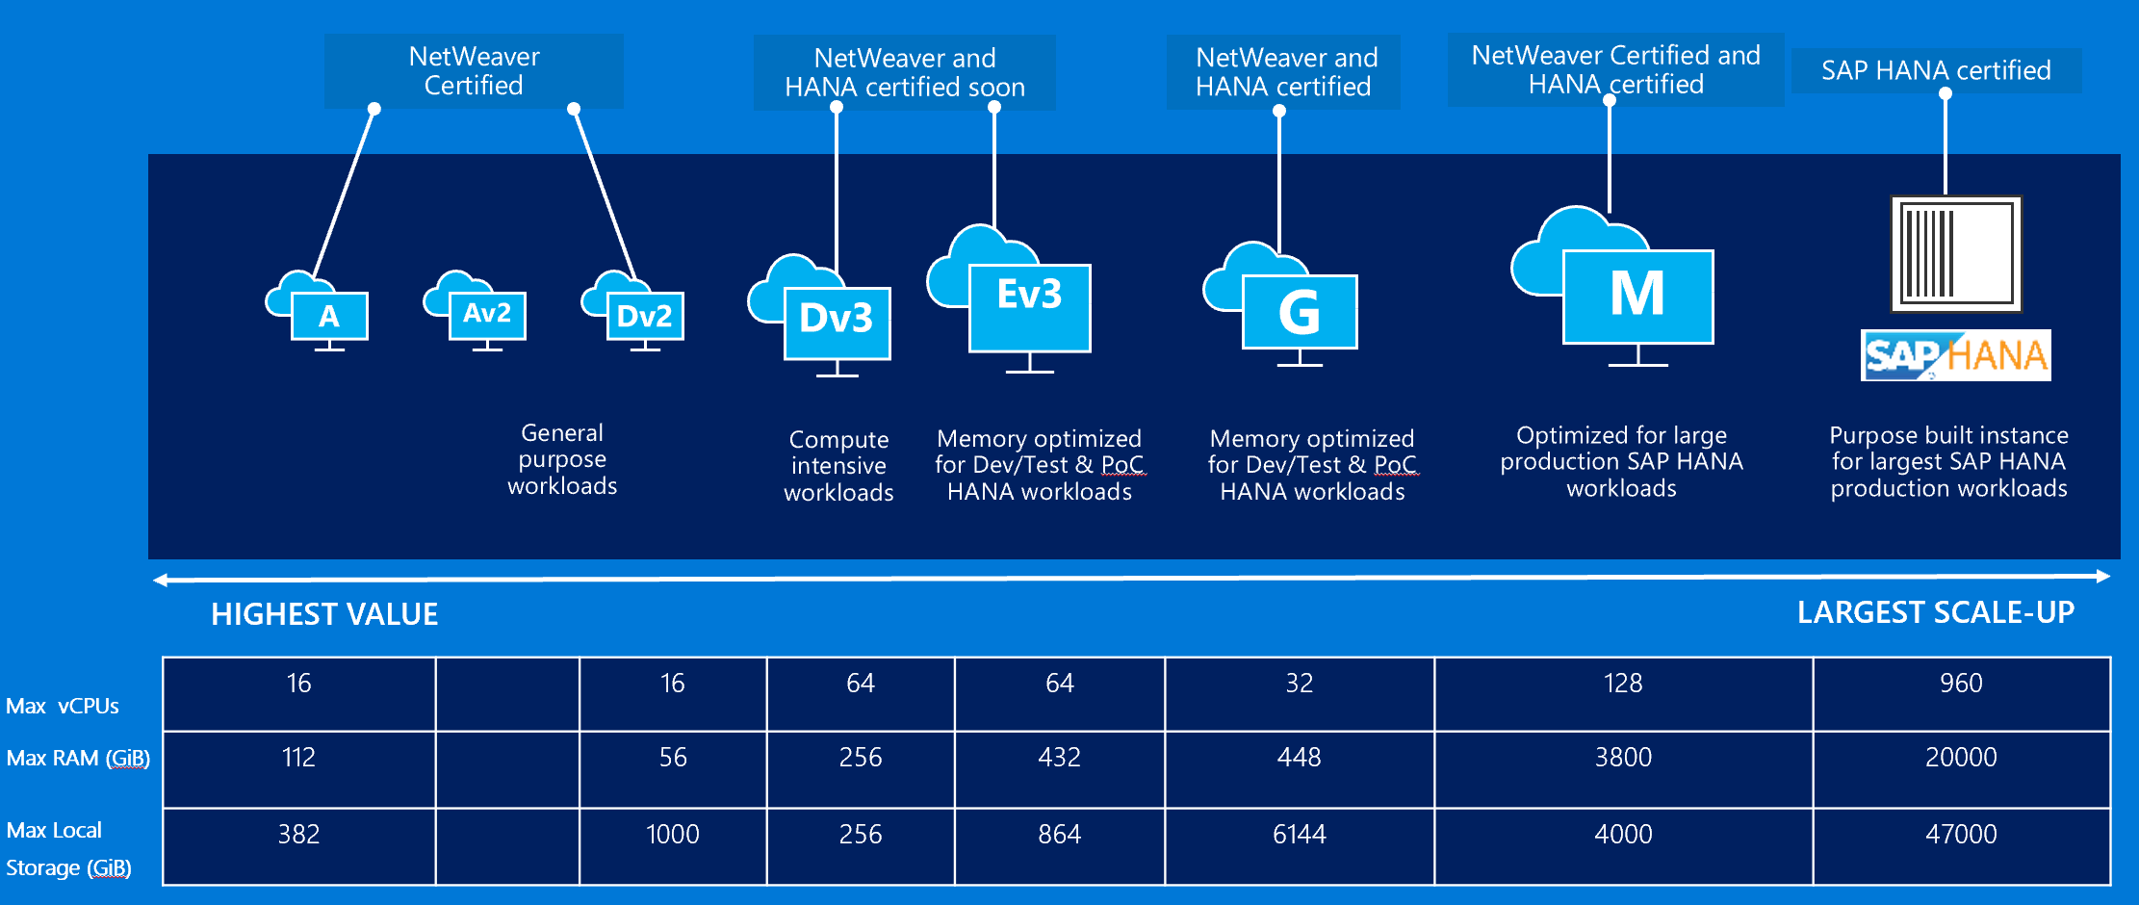
SAP on Azure — huge variety on instances

Slide 13
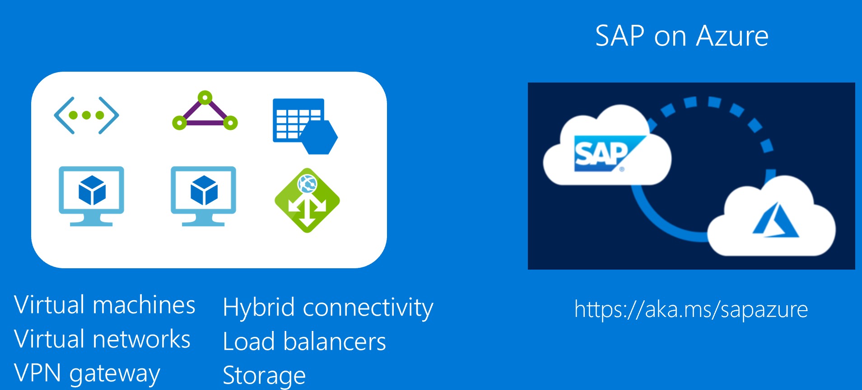
Common scenarios
Notes:
Common solutions for the case study include virtual machines, virtual networks, VPN gateway, hybrid connectivity, load balancers, and storage, as well as SAP on Azure, with more information available via https://aka.ms/sapazure

Slide 14
Determine Azure SKUs for HANA based on HANA DB Size and SAPS
 | HANA Scenario and DB/RAM size | Select a Compute SKU based of RAM size required for HANA Database server(s) | Combine Compute SKUs based on SAPS required for SAP application servers
1 | Dev and Test up to 4TiB (of RAM) | E16s v3, E32s v3, E64s v3, M32ls, M32ts, M64ls, M64s, M64ms, M128s, M128ms | D v3, E v3, Fractional M VMs – scale out
2 | Production - OLTP 192GiB to 4TiB (of RAM) | M32ls, M32ts, M64ls, M64s, M64ms, M128s, M128ms – scale up | D v3, E v3, Fractional M VMs – scale out
3 | Production – OLTP 4.1 to 24TiB (of RAM) | HANA Large Instances S192xm, S384m…. S960m, S768xm – scale up | D v3, E v3, Fractional M VMs – scale out
4 | Production – OLAP 1 to 2TiB (of RAM) | M64s, M128s – scale up | D v3, E v3, Fractional M VMs – scale out
5 | Production – OLAP 2.1 to 4TiB (of RAM) | HANA Large Instances S384 – scale up | D v3, E v3, Fractional M VMs – scale out
6 | Production – OLAP 4.1 to 60TiB (of RAM) | HANA Large Instances S72, S96, S192 and S384 – multiple nodes Scale out up to 16 nodes | D v3, E v3, Fractional M VMs – scale out
(*) OLAP : BW on HANA, BW/4HANA, Enterprise DWH, Sidecar | OLTP : S/4HANA, Business Suite on HANA, NetWeaver

Slide 15
M-Series Virtual Machines Massive memory, CPU, storage, and scale
Hyper-Threaded support
Premium Storage and Write Accelerator support
Based on Intel® Xeon® Processor E7-8890 v3
High Performance DDR4 memory
SAP Certified for both HANA and AnyDB
(*) OLAP : BW on HANA, BW/4HANA, Enterprise DWH, Sidecar
(*) OLTP : S/4HANA, Business Suite on HANA, NetWeaver
VM size | vCPU | Memory: GiB | SAPS | Max cached IOPS | Max cached storage throughput (GiB) | Network Bandwidth | HANA Workload
M32ts | 32 | 192 | 33,670 | 40,000 | 400 | 8 Gbps | OLTP
M32ls | 32 | 256 | 33,300 | 40,000 | 400 | 8 Gbps | OLTP
M64ls | 64 | 512 | 66,600 | 80,000 | 800 | 16 Gbps | OLTP
M64s | 64 | 1,024 | 67,315 | 80,000 | 800 | 16 Gbps | OLAP and OLTP
M64ms | 64 | 1,792 | 68,930 | 80,000 | 800 | 16 Gbps | OLTP
M128s | 128 | 2,048 | 134,630 | 160,000 | 1,600 | 25 Gbps | OLAP and OLTP
M128ms | 128 | 3,800 (= 4,080 GB) | 134,630 | 160,000 | 1,600 | 25 Gbps | OLTP
Notes:
Key talking points:
The M-series is the largest instance size with up to 128 virtual cpu’s (VCPUs). These instances support premium storage for low latency workloads and are designed for the largest enterprise workloads. These have huge RAM sizes from 1.75TB to 4.0TB of RAM!

Slide 16
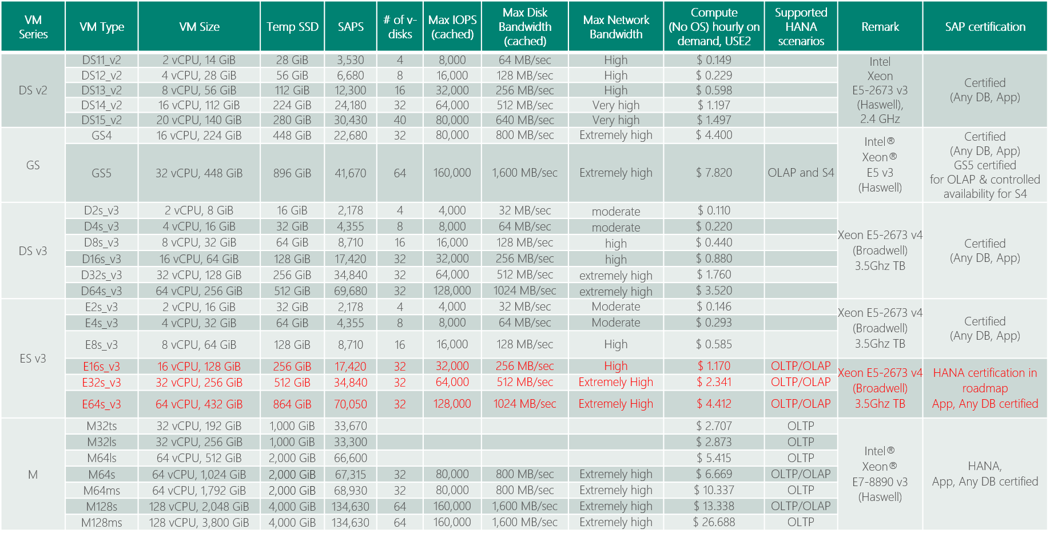
(SAPS) Azure VM Options for SAP Applications
SAP Note 1928533 and https://docs.microsoft.com/en-us/azure/virtual-machines/windows/sizes-memory
Red: certification in roadmap

Slide 17
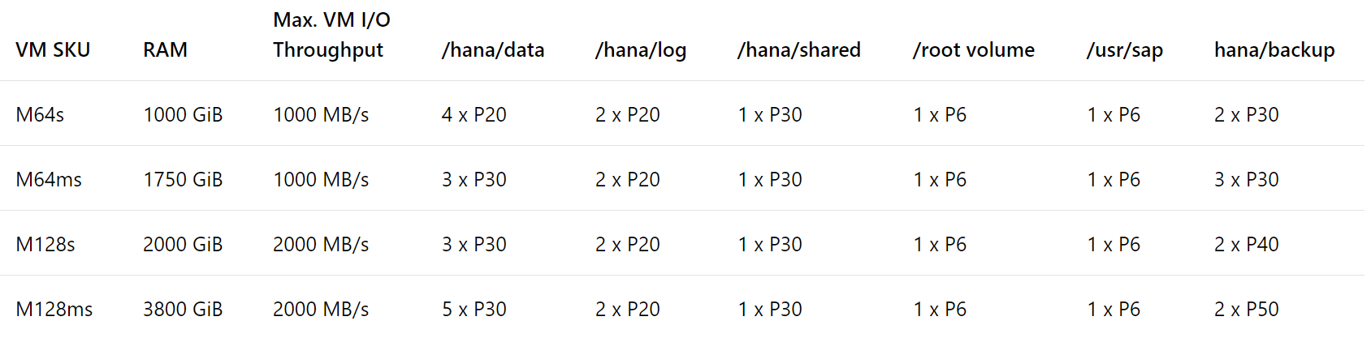
Premium Storage Allocation to run SAP HANA on Azure M Series VM
Enable Write Accelerator
All the disks building those volumes should have caching of those disks set to 'None'.
https://docs.microsoft.com/en-us/azure/virtual-machines/workloads/sap/hana-vm-operations
As stripe sizes for the RAID 0 the recommendation is to use:
64K or 128K for /hana/data
32K for /hana/log (as Only smaller I/O sizes (<=32KiB) are taking the accelerated path of Write Accelerator)
https://docs.microsoft.com/en-us/azure/virtual-machines/linux/how-to-enable-write-accelerator

Slide 18

Premium Storage KPIs (Cost differ by region)
Premium Storage Disk Type | P4 | P6 | P10 | P15 | P20 | P30 | P40 | P50
Disk size | 32 GB | 64 GB | 128 GB | 256 GB | 512 GB | 1024 GB (1 TB) | 2048 GB (2 TB) | 4096 GB (4 TB)
IOPS per disk | 120 | 240 | 500 | 1100 | 2,300 | 5,000 | 7,500 | 7,500
Throughput per disk | 25 MB/s | 50 MB/s | 100 MB/s | 125 MB/s | 150 MB/s | 200 MB/s | 250 MB/s | 250 MB/s
Consistent low latency SSD with predictable throughput
For high-performance IO-intensive DB workloads
Single digit ms latencies
Supports up to 4 TB blob/disk size
Stripe up to 64 disks for a total of 256 TB
Disk performance is dependent on the disk size, with up to 7,500 IOPS per disk
Pay for what you provision
Check Azure VMs for maximum IOPS
* Stripe Premium Storage Disks to aggregate
IOPS, Throughput and Storage Capacity

Slide 19
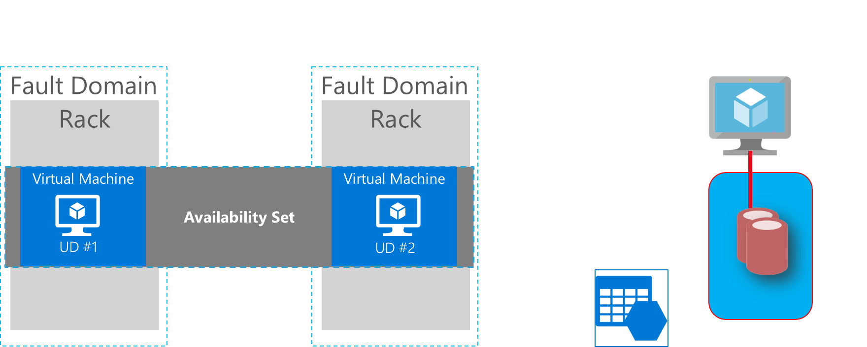
Common Scenarios

Slide 20
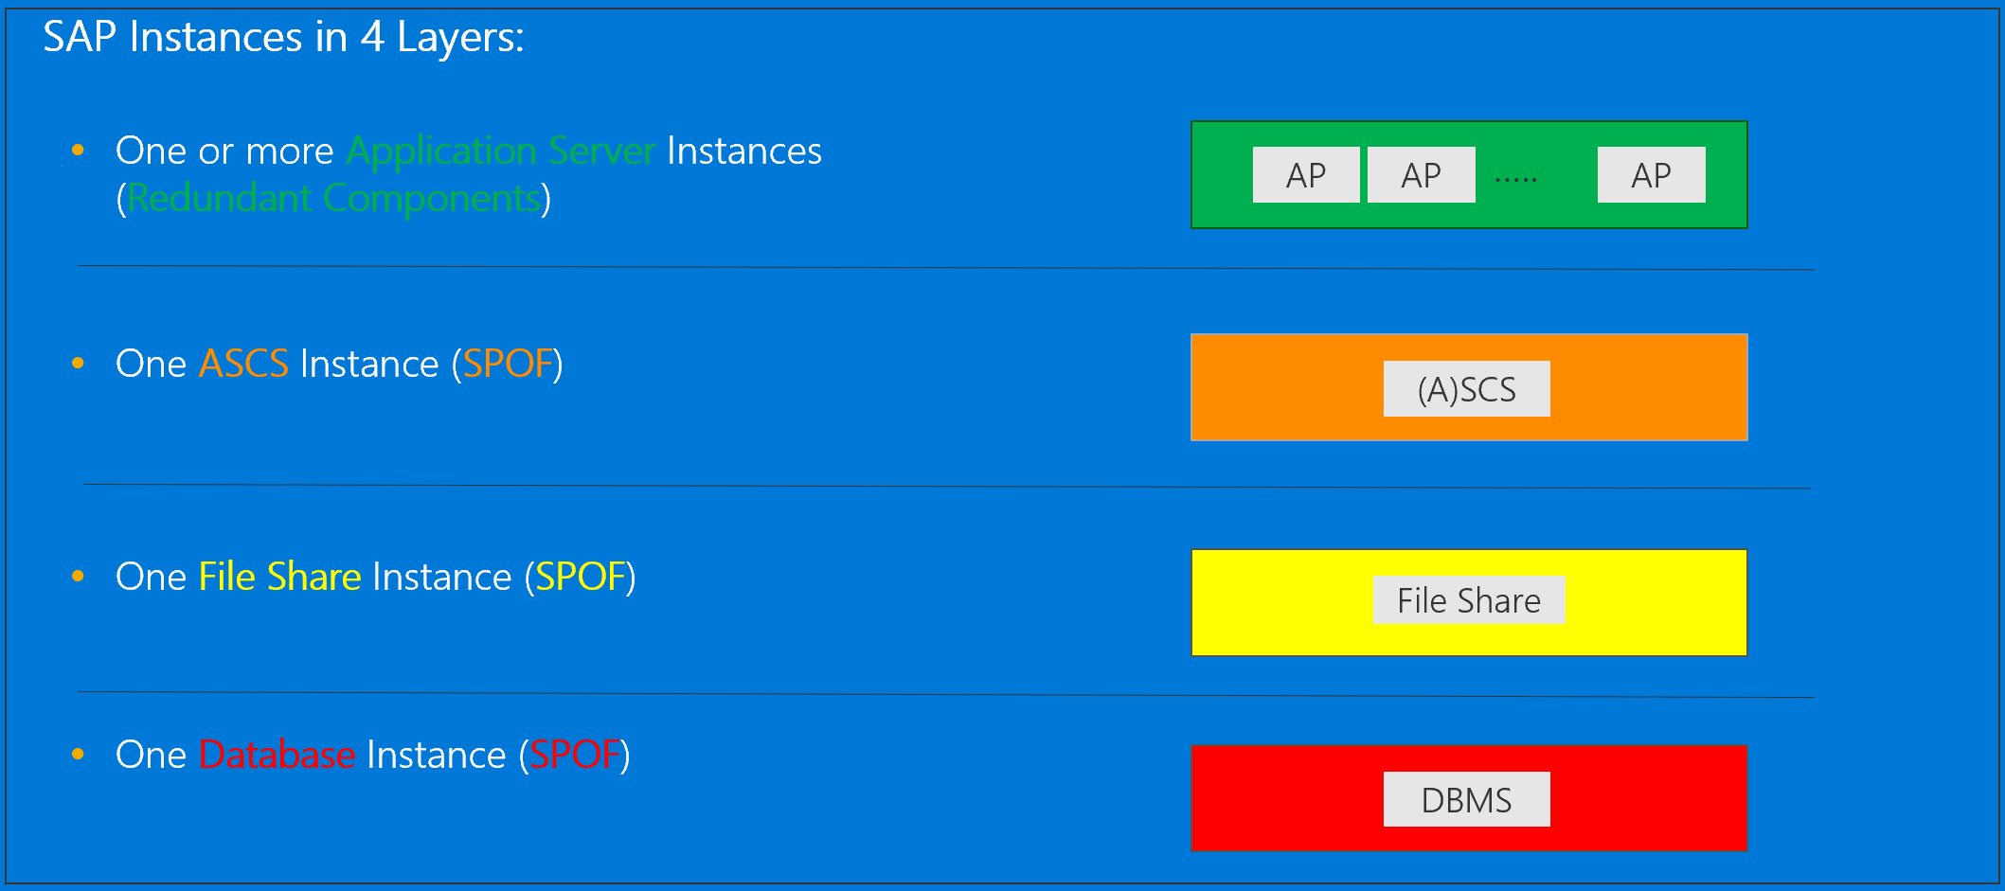
SAP HA Architecture SAP NetWeaver ABAP / Java 7.00 (and higher) – Windows & Linux

Slide 21
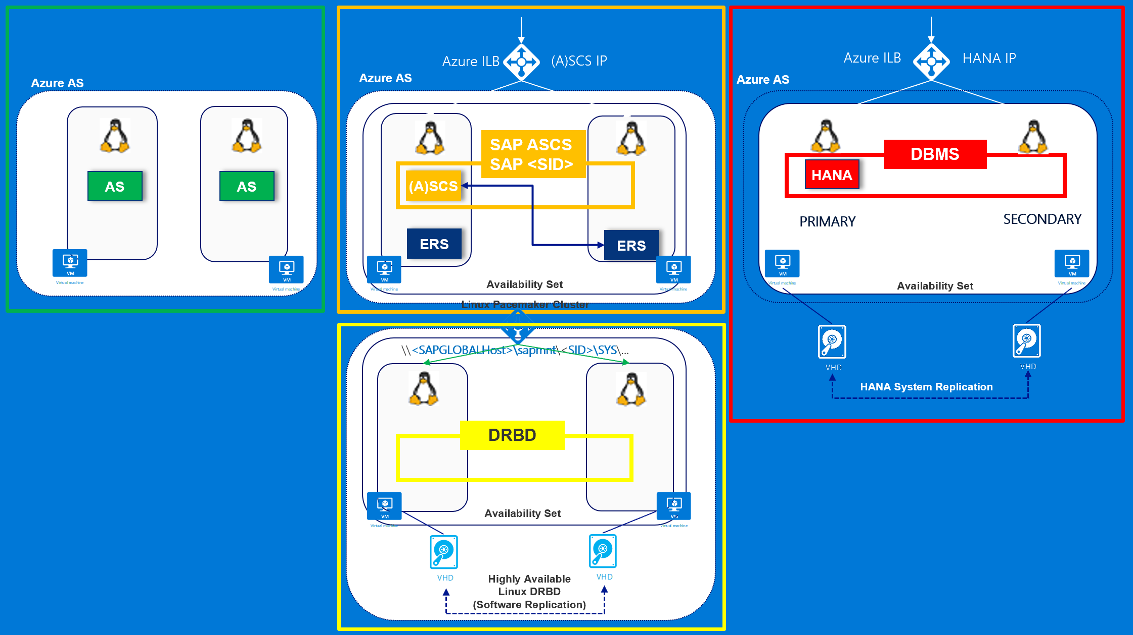

Slide 22
Step 2: Design the solution
Outcome
Design a solution and prepare to present the solution to the target customer audience in a 15-minute chalk-talk format.
Timeframe
60 minutes
Business needs (10 minutes) | Respond to questions outlined in your guide and list the answers on a flipchart.
Design (35 minutes) | Design a solution for as many of the stated requirements as time allows. Show the solution on a flipchart.
Prepare (15 minutes) | Identify any customer needs that are not addressed with the proposed solution. Identify the benefits of your solution. Determine how you will respond to the customer’s objections. Prepare for a 15-minute presentation to the customer.

Slide 23










Partner Admin Network
Azure East US 2 Region
Web
Azure VNET (Hub)
Azure VNET (Spoke – SAP Prod/Non-Prod)
Customer Corporate Network
GW Subnet
Subnet DMZ
Subnet Shared Management
Subnet Prod BW AP+DB
Storage
Subnet Non- Prod BW AP+DB
Subscription
Running SAP HANA on Azure VM HA

Slide 24
Partner Admin Network
8
3
How to size storage to store backup ?
Where to deploy Jumpbox, Patching, DNS, Backup ?
Internet VPN?
5
Azure East US 2 Region
4
7
How to deploy highly available HANA DB and allocate storage for Production (1.2 -> 1.9TB) ?
How to allocate storage for data, log, shared, root and backup ?
Web
How to deploy VMs for SAP AP servers ? (15k SAPS)
Azure VNET (Hub)
Azure VNET (Spoke – SAP Prod/Non-Prod)
Customer Corporate Network
Internet VPN or private connect ?
GW Subnet
Subnet DMZ
Subnet Shared Management
Subnet Prod BW AP+DB
Storage
2
Subnet Non- Prod BW AP+DB
9
Subscription
How to deploy VMs for highly available SAP ASCS and NFS on Linux Clusters ?
How to deploy VMs and allocate storage for SAP AP Servers and HANA DB (800GB) for QA, Dev and Test (256GB each) ?
Running SAP HANA on Azure VM HA
Make sure to use VNET Hub-spoke topology
6
1

Slide 25







Baseline knowledge for SAP as a service on Azure
Icon | Name | Description
 | Region | An area within a geo that does not cross national borders and contains one or more datacenters.
 | Subscription | A customer's agreement with Microsoft that enables them to obtain Azure services.
 | Azure Active Directory (Tenant) | Azure Active Directory helps you manage user identities and create intelligence-driven access policies to secure your resources.
 | ExpressRoute | Direct Connectivity from customer network to Microsoft Enterprise Edge (MSEE)
 | MSEE (Enterprise Edge) | Each ExpressRoute circuit consists of two connections to two Microsoft Enterprise edge routers (MSEEs) from the connectivity provider/your network edge.
 | Virtual Network | A network that provides connectivity between your Azure resources that is isolated from all other Azure tenants.
 | Subnet | A subnetwork or subnet is a logical subdivision of an IP network.
 | Network Security Group | NSG contains a list of security rules that allow or deny network traffic to resources connected to Azure Virtual Networks (VNet)
 | VPN Gateway | A specific type of virtual network gateway that is used to send encrypted traffic between an Azure virtual network and an on-premises location over internet.
 | ExpressRoute Gateway | A specific type of virtual network gateway that is used to send traffic between an Azure virtual network and an on-premises location over ExpressRoute/Direct Peering.
 | Virtual Machines | The software implementation of a physical computer that runs an operating system.
 | Azure Premium Storage and Managed Disks | Azure Storage offers a massively scalable object store for data objects, a file system service for the cloud
 | Availability Set | A collection of virtual machines that are managed together to provide application redundancy and reliability.
 | Internal Load Balancer | ILB directs traffic only to resources that are inside a virtual network or that use a VPN to access Azure infrastructure. (Layer 4)
 | HANA on Azure Large Instances | HANA tailored data center integration (TDI) certified server hardware infrastructure
 | NFS Storage | HANA tailored data center integration (TDI) certified storage infrastructure
 | High Availability Pair | two or more identical HANA large instances deployed in the same region and configured by the customer for system replication
 | Backend ExpressRoute | Backend network to connect Azure Virtual Network and HANA Large Instances stamp
 | Azure Backbone Network | Microsoft owned global fiber network linking all Azure datacenters
 | Regional Pairs | Regional protection within data residency boundaries
MSEE

Slide 26
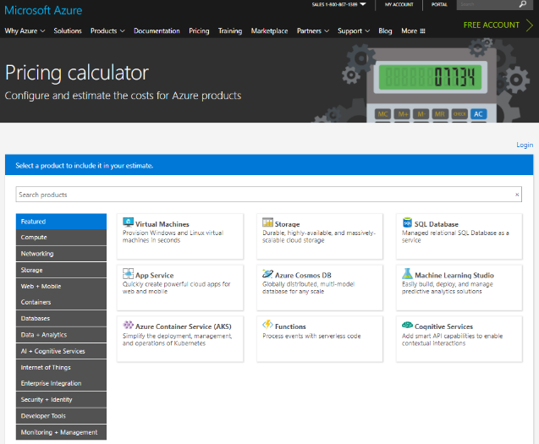
Online Azure pricing calculator
https://azure.microsoft.com/en-us/pricing/calculator/
Notes:
To estimate the cost of your solution, use Azure Pricing Calculator.

Slide 27
Pricing
** Customer is very cost sensitive
No need to include OS/DB license costs (Customer will do BYOL separately)
Do BYOL of 3rd party backup solution (e.g. Commvault)
ExpressRoute : Start with 500Mbps
ExpressRoute Additional outbound data transfer : 5TB/month
Make sure to include MSFT support (= Professional Direct)

Slide 28
Step 3: Present the solution
Outcome
Present a solution to the target customer in a 15-minute chalk-talk format.
Timeframe
30 minutes (15 minutes for each team to present and receive feedback)
Directions
Pair with another table.
One table is the Microsoft team and the other table is the customer.
The Microsoft team presents their proposed solution to the customer.
The customer asks one of the objections from the list of objections in the case study.
The Microsoft team responds to the objection.
The customer team gives feedback to the Microsoft team.

Slide 29
Wrap-up
Outcome
Identify the preferred solution for the case study.
Identify solutions designed by other teams.
Timeframe
15 minutes

Slide 30
Preferred target audience
Business Development Manager (BDM) or Application Sponsor (CFO)
Funds projects & apps
Most interested in public cloud
Business Unit IT / Developers (Director of SAP Business Analysts, Director of SAP Operations)
Reports to BDM and is responsible for coding and testing apps
Big influencer of public cloud strategy
Central IT (VP of IT Operations)
Reports into CIO and responsible for operating datacenter
Concerned about shadow IT created issues: security/compliance, server sprawl, and lack of control

Slide 31
SAP HANA on Cloud
Agility to Scale
In-memory Database Performance
High Availability & Disaster Recovery
Enterprise Data Protection & Security
Safe and Easy Migration
IT standardization between SAP and Non-SAP
1
2
3
4
5
6

Slide 32
Preferred solution
Azure VMs - no HA
Azure VMs - HA with no DR
Azure VMs - HA and DR

Slide 33
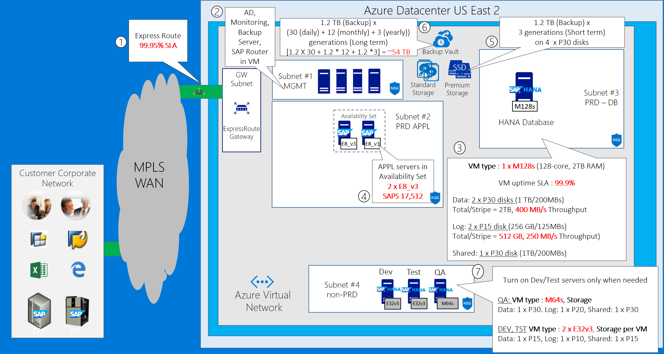
BW on HANA without HA
Notes:
The first option delivers the core functionality without SAP HANA high availability and disaster recovery capabilities. It accommodates a hybrid scenario, with the customer’s on-premises corporate network and an Azure datacenter in the East US 2 region. For cross-premises connectivity, it leverages the MPLS-based ExpressRoute circuit. The solution also includes a standalone HANA production database running on a Standard M128s, memory-optimized Azure VM. The Azure VM is configured with two P30 disks, striped into a single volume hosting data files, which deliver total of 2 TB of disk space and 400 MB/s throughput. Logs are stored on a volume residing on two P15 disks that deliver combined 512 GB of disk space and 250 MB/s throughput. The shared HANA volume uses one P30 disk, with 1 TB of disk space and 200 MB/s throughput. In addition to the Azure VM hosting HANA DB, the solution includes a pair of Azure VMs virtual machines that serve as the ASCS and the application servers. This satisfies the customer requirement, according to which the Business Warehouse application servers must be able to handle 15,000 SAPS. Two E8_v3 Azure VMs give us total of 18,512 SAPS.

Slide 34
Cost: BW on HANA without HA
Environment | Category | Service | Region | Quantity | Usage | Description | Cost | Rationale
Production | Compute | VM/M128s/Linux | US East 2 | 1 | RI/1yr | HANA PRD DB Server | $5584.5 | DB Size 1.2 TB - fits to 2TB M128s with head-room
Production | Storage | P30/1024 GB | US East 2 | 2 | - | HANA PRD DB Files | $245.76 | 2 TB capacity + 400 MB/s Throughput
Production | Storage | P15/256 GB | US East 2 | 2 | - | HANA PRD Log Files | $69.12 | 512 GB capacity + 250MB/s Throughput
Production | Storage | P30/1024 GB | US East 2 | 1 | - | HANA PRD Shared | $122.88 | 1 TB capacity
Production | Compute | VM/E8_v3/Linux | US East 2 | 2 | RI/1yr | SAP BW APPL Server | $548.00 | 17512 SAPS
QA | Compute | VM/M64s/Linux | US East 2 | 1 | 50 | HANA QA DB Server | $333.45 | DB Size 800 GB - fits to 1TB M64s with head-room
QA | Storage | P30/1024 GB | US East 2 | 1 | - | HANA QA DB Files | $122.88 | 1 TB capacity accomodates 800GB database
QA | Storage | P20/512 GB | US East 2 | 1 | - | HANA QA Log Files | $66.56 | 1/2 * RAM
QA | Storage | P30/1024 GB | US East 2 | 1 | - | HANA QA Shared | $122.88 | 1 * RAM
TEST | Compute | VM/E32_v3/Linux | US East 2 | 1 | 200 | HANA TEST DB Server | $468.20 | DB Size 256 GB - fits to E32_v3
TEST | Storage | P15/256 GB | US East 2 | 1 | - | HANA TEST DB Files | $34.56 | 1 * RAM
TEST | Storage | P10/128 GB | US East 2 | 1 | - | HANA TEST Log Files | $17.92 | 1/2 * RAM
TEST | Storage | P15/256 GB | US East 2 | 1 | - | HANA TEST Shared | $34.56 | 1 * RAM
DEV | Compute | VM/E32_v3/Linux | US East 2 | 1 | 200 | HANA TEST DB Server | $468.20 | DB Size 256 GB - fits to E32_v3
DEV | Storage | P15/256 GB | US East 2 | 1 | - | HANA TEST DB Files | $34.56 | 1 * RAM
DEV | Storage | P10/128 GB | US East 2 | 1 | - | HANA TEST Log Files | $17.92 | 1/2 * RAM
DEV | Storage | P15/256 GB | US East 2 | 1 | - | HANA TEST Shared | $34.56 | 1 * RAM
Backup | Storage | P30/1024 GB | US East 2 | 4 | - | Backup/Fast Short-Term | $491.52
Backup | Storage | Cold/BLOB | US East 2 | - | - | Backup/Long Term (52TB) | $840.00 | 1.2 X 30 + 1.2 * 12 + 1.2 *3 = ~54 TB
- | Network | Express Route | US East 2 | 1 |  | 500 Mbit | $290.00
- | Network | Express Route Data Plan | US East 2 | 1 |  | 5 TB Data-Plan | $128.00
- | Network | ER Gateway | US East 2 | 1 | 744 | ER GW High Performance | $364.56
 |  |  |  |  |  | Total | $13,183.08
NOT INCLUDED : AD, Backup, Monitoring Server, Database licenses, MPLS (telco), Microsoft Premier Support, Managed Services
Notes:
And here is detailed pricing information representing our first proposed solution. The bulk of charges is associated with the networking and compute components. More specifically, they include the cost of ExpressRoute unlimited data plan at 500 Mbps and the cost of the production HANA DB M128s virtual machine running on 24-7 basis.
The remaining costs include the compute components that constitute the SAP application tier and the infrastructure of our production environment, as well as compute components of the dev/test and QA environments. In addition, we need to account for the premium storage implemented across both the production and non-production virtual machines. Keep in mind that it is a monthly cost that does not depend on the usage patterns. We also have to take into account the cost of backup, which factors in the number of protected instances and the projected amount of occupied space.
Note that the current slide does not take into account licensing costs, ExpressRoute telco charges, pricing of the Microsoft Premier Support which is required when deploying SAP production solutions in Azure, and any managed services.

Slide 35
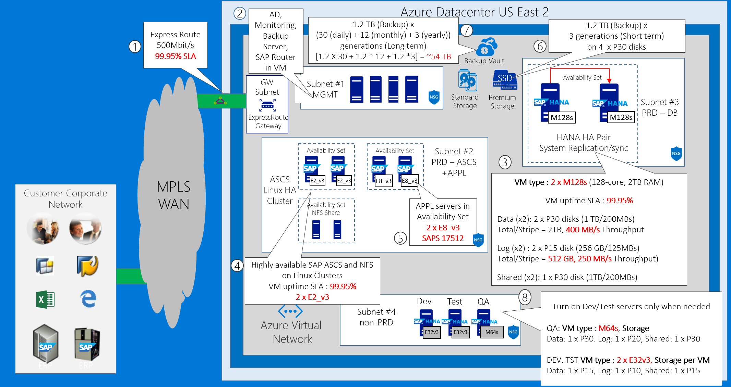
BW on HANA with HA
Notes:
The second option delivers the same core functionality as the first option but, in addition, it provides high availability for the SAP HANA components. This is accomplished by provisioning two identically configured M128s Azure VM into the same availabilty set. The two Azure VMs form the database tier and host two identically configured HANA instances replicating synchronously with each other by using HANA System Replication. Implementing high availability in the application tier involves provisioning two pairs of Azure VMs, with each pair in its own availability set. The first pair consists of two E2_v3 Azure VMs hosting SAP ASCS and NFS components. The second pair consists of a two E8_v3 Azure VMs, forming a Linux-based cluster, hosting the application servers and delivering total of 17,512 SAPS.

Slide 36
Cost: BW on HANA with HA
Environment | Category | Service | Region | Quantity | Usage | Description | Cost | Rationale
Production | Compute | VM/M128s/Linux | US East 2 | 2 | RI/1yr | HANA PRD DB Server | $11169.00 | DB Size 1.2 TB - fits to 2TB M128s with head-room
Production | Storage | P30/1024 GB | US East 2 | 4 | - | HANA PRD DB Files | $491.52 | 2 TB capacity + 400 MB/s Throughput
Production | Storage | P15/256 GB | US East 2 | 4 | - | HANA PRD Log Files | $138.24 | 512 GB capacity + 250MB/s Throughput
Production | Storage | P30/1024 GB | US East 2 | 2 | - | HANA PRD Shared | $245.76 | 1 TB capacity
Production | Compute | VM/E8_v3/Linux | US East 2 | 2 | RI/1yr | SAP BW APPL Server | $548.00 | 17512 SAPS
Production | Compute | VM/E2_v3/Linux | US East 2 | 2 | RI/1yr | SAP BW ASCS/NFS | $137.00 | SAP ASCS/NFS Availability Set
Production | Compute | VM/E2_v3/Linux | US East 2 | 2 | RI/1yr | NFS Server | $137.00 | NFS Server Availability Set
QA | Compute | VM/M64s/Linux | US East 2 | 1 | 50 | HANA QA DB Server | $333.45 | DB Size 800 GB - fits to 1TB M64s with head-room
QA | Storage | P30/1024 GB | US East 2 | 1 | - | HANA QA DB Files | $122.88 | 1 TB capacity accomodates 800GB database
QA | Storage | P20/512 GB | US East 2 | 1 | - | HANA QA Log Files | $66.56 | 1/2 * RAM
QA | Storage | P30/1024 GB | US East 2 | 1 | - | HANA QA Shared | $122.88 | 1 * RAM
TEST | Compute | VM/E32_v3/Linux | US East 2 | 1 | 200 | HANA TEST DB Server | $468.20 | DB Size 256 GB - fits to E32_v3
TEST | Storage | P15/256 GB | US East 2 | 1 | - | HANA TEST DB Files | $34.56 | 1 * RAM
TEST | Storage | P10/128 GB | US East 2 | 1 | - | HANA TEST Log Files | $17.92 | 1/2 * RAM
TEST | Storage | P15/256 GB | US East 2 | 1 | - | HANA TEST Shared | $34.56 | 1 * RAM
DEV | Compute | VM/E32_v3/Linux | US East 2 | 1 | 200 | HANA TEST DB Server | $468.20 | DB Size 256 GB - fits to E32_v3
DEV | Storage | P15/256 GB | US East 2 | 1 | - | HANA TEST DB Files | $34.56 | 1 * RAM
DEV | Storage | P10/128 GB | US East 2 | 1 | - | HANA TEST Log Files | $17.92 | 1/2 * RAM
DEV | Storage | P15/256 GB | US East 2 | 1 | - | HANA TEST Shared | $34.56 | 1 * RAM
Backup | Storage | P30/1024 GB | US East 2 | 4 | - | Backup/Fast Short-Term | $491.52
Backup | Storage | Cold/BLOB | US East 2 | - | - | Backup/Long Term (52TB) | $840.00 | 1.2 X 30 + 1.2 * 12 + 1.2 *3 = ~54 TB
- | Network | Express Route | US East 2 | 1 |  | 500 Mbit | $290.00
- | Network | Express Route Data Plan | US East 2 | 1 |  | 5 TB Data-Plan | $128.00
- | Network | ER Gateway | US East 2 | 1 | 744 | ER GW High Performance | $364.56
 |  |  |  |  |  | Total | $19,479.34
NOT INCLUDED : AD, Backup, Monitoring Server, Database licenses, MPLS (telco), Microsoft Premier Support, Managed Services
Notes:
And here is detailed pricing information representing our first proposed solution. The bulk of charges is associated with the networking and compute components. More specifically, they include the cost of ExpressRoute unlimited data plan at 500 Mbps and the cost of the production HANA DB M128s virtual machine running on 24-7 basis.
The remaining costs include the compute components that constitute the SAP application tier and the infrastructure of our production environment, as well as compute components of the dev/test and QA environments. In addition, we need to account for the premium storage implemented across both the production and non-production virtual machines. Keep in mind that it is a monthly cost that does not depend on the usage patterns. We also have to take into account the cost of backup, which factors in the number of protected instances and the projected amount of occupied space.
Note that the current slide does not take into account licensing costs, ExpressRoute telco charges, pricing of the Microsoft Premier Support which is required when deploying SAP production solutions in Azure, and any managed services.

Slide 37
SAP HANA HA on Azure VMs Setup Sequence
Provision Azure infrastructure and two Azure Linux VMs (Azure)
Update Linux OS (Linux)
Install HA Extensions (Linux)
Set up disk layout (Linux)
Configure name resolution (Azure or Linux)
Install cluster (Linux)
Configure Corosync (Linux)
Install HANA HA packages (Linux)
Install SAP HANA (SAP)
Upgrade SAP Host Agent (SAP)
Configure HANA replication (SAP)
Configure Cluster Framework (Linux)
Create STONITH device (Azure and Linux)
Register SAP HANA resources (Linux)

Slide 38
SAP HANA HA on Azure VMs Setup Sequence – detailed
Provision Azure infrastructure and two Azure Linux VMs (SLES-for-SAP Applications 12 SP1) using the Azure Resource Manager model.
Register SLES to ensure access to package repositories (BYOS only), add the public-cloud module, update OS (sudo zipper update).
Install HA Extensions (sudo zypper install sle-ha-release fence-agents).
Set up disk layout.
Configure name resolution (DNS or /etc/hosts).
Notes:
Provision Azure infrastructure and two Azure Linux VMs (SLES-for-SAP Applications 12 SP1) using the Azure Resource Manager model
The same virtual network, subnet, and availability set, separate Premium Storage accounts
Attach Azure Premium storage disks to each VM
Create an internal load balancer
Back-end pool consisting of both Azure VMs, health probe set to TCP 62503, Load balancing rules: TCP 30315 and 30317, Direct Server Return enabled for both
To automate, use the GitHub database template https://portal.azure.com/#create/Microsoft.Template/uri/https%3A%2F%2Fraw.githubusercontent.com%2FAzure%2Fazure-quickstart-templates%2Fmaster%2Fsap-3-tier-marketplace-image-multi-sid-db%2Fazuredeploy.json
Register SLES to ensure access to package repositories (BYOS only), add the public-cloud module, update OS (sudo zipper update)
Install HA Extensions (sudo zypper install sle-ha-release fence-agents)
4. Set up disk layout
Create physical volumes for all disks that you want to use
Create a volume group for the data files, the log files and the shared HANA directory
Create the logical volumes
Create the mount directories and copy the UUID of all logical volumes
Create fstab entries for the three logical volumes
Mount the new volumes

Slide 39
SAP HANA HA on Azure VMs Setup Sequence – (continued)
Install cluster on the first node (sudo ha-cluster-init) and join the second node to the cluster (sudo ha-cluster-join).
Configure corosync transport and nodelist settings (edit /etc/corosync/corosync.conf) and restart corosync service.
Install HANA HA packages (sudo zypper install SAPHanaSR).
Run hdblcm to install SAP HANA.
Upgrade SAP Host Agent.
Configure HANA replication (create keystore, create the primary site, create the secondary site).
Configure Cluster Framework.
Create STONITH device (register an Azure AD app and a corresponding Service Principal, configure the cluster STONITH device).
Register SAP HANA resources.

Slide 40
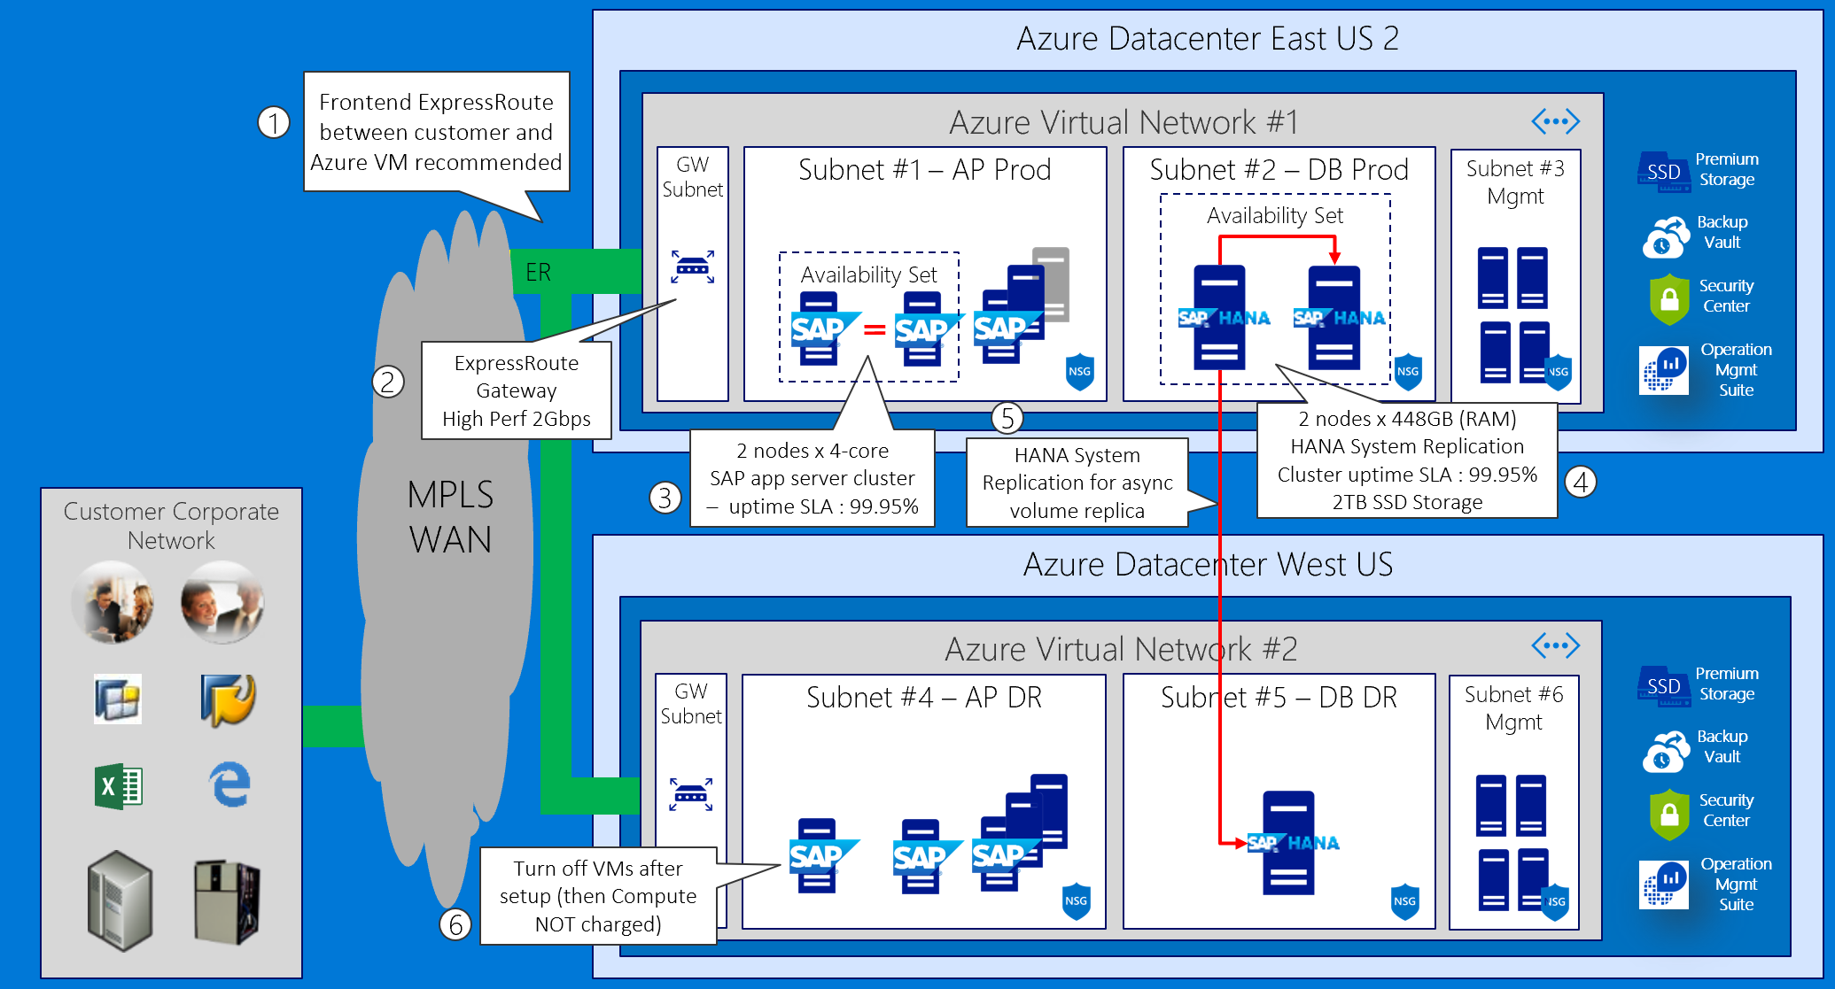
S/4HANA, BW on HANA, HANA Enterprise, Side Car – VM with HA/DR
Notes:
To further enhance our design by providing disaster recovery capabilities, we create a virtual network in the West US Azure region and leverage MPLS-based ExpressRoute to provide cross-region and cross-premises connectivity. Next, we deploy another M128s Azure VM in the newly provisioned virtual network and configure it with asynchronous HANA system replication from the cluster hosting the primary database instance. We also implement a standby disaster recovery environment for the application tier.

Slide 41
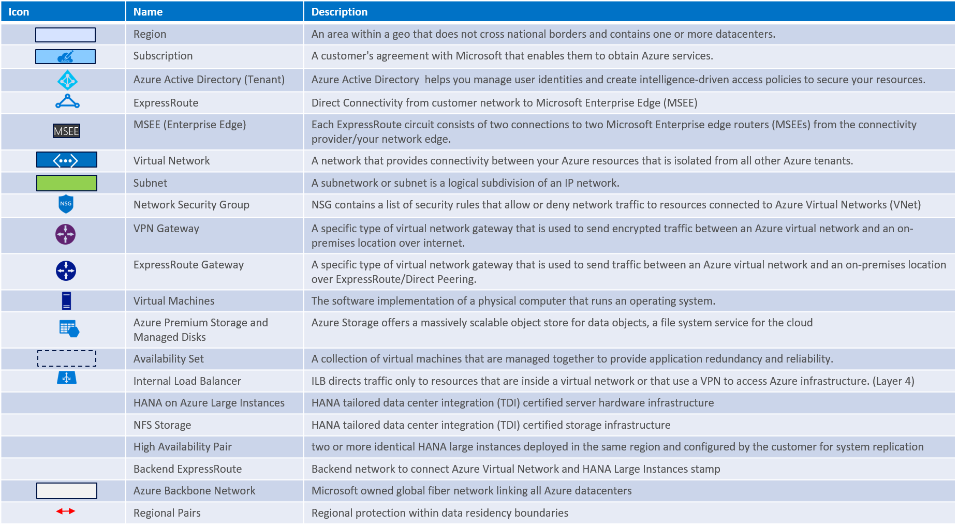
Baseline knowledge for SAP as a service on Azure

Slide 42
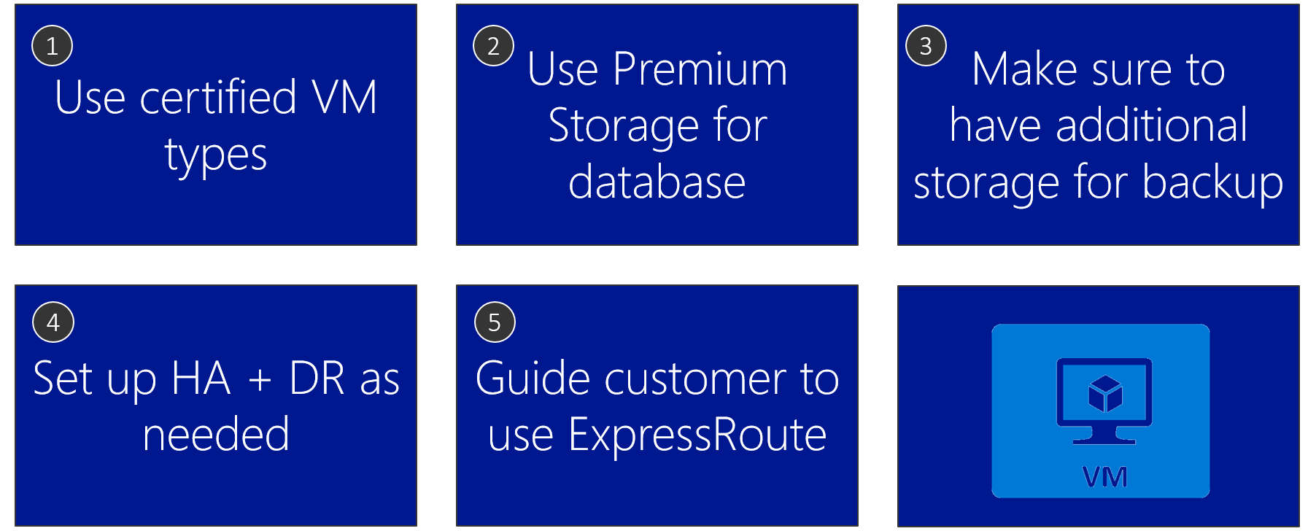
Azure VM design tips
Notes:
The proposed design:
Uses SAP certified VM sizes (required)
Uses Premium Storage for databases (required)
Accounts additional storage for backup (as per customer’s specifications)
HA/DR (as per customer’s specifications)
Uses ExpressRoute (as per customer’s specifications)

Slide 43
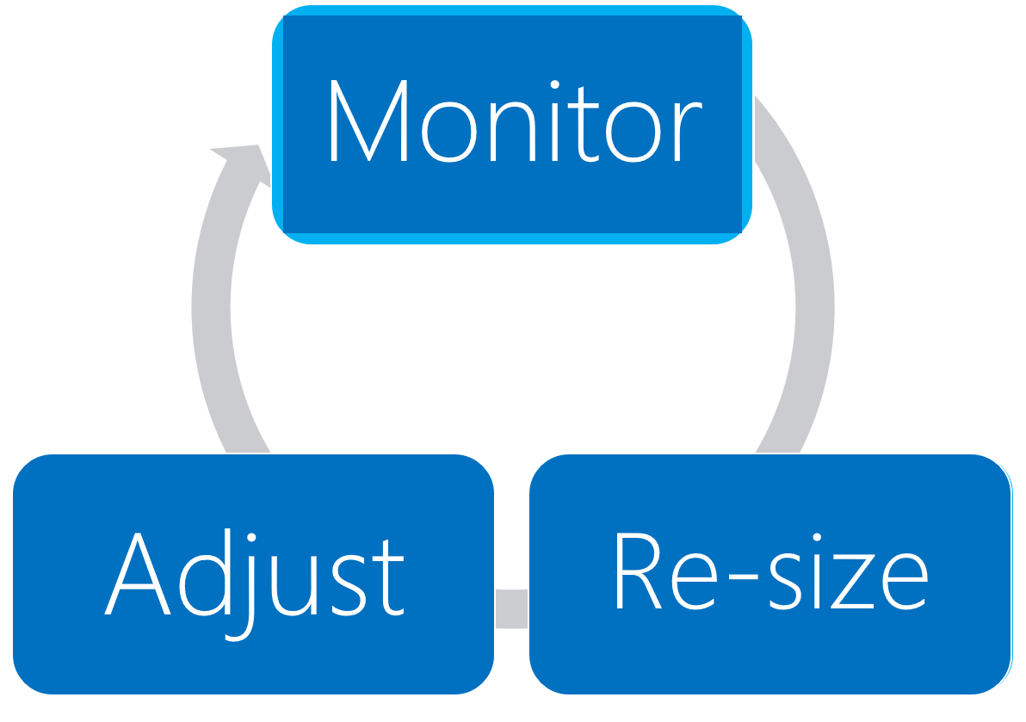
Process to optimize SAP landscape
Notes:
The solution sizing is a continuous process that involve monitoring, re-sizing, and adjusting. Fortunately, resizing Azure VMs is a straightforward process.

Slide 44
Preferred objections handling
ECC remains on-premises until Dec CY18 – how can we maintain integrations between ECC and BW?
Microsoft supports a hybrid solution, with symmetry between on-premises applications and those on the public cloud .
Windows Azure Virtual Network allows to create a logically isolated section in Azure and securely connect it to on premises datacenters.
ExpressRoute provides secure, high-bandwidth, low-latency connectivity between Azure and on-premises datacenters.

Slide 45
Preferred objections handling
How much does Azure cost? Give us a few options (e.g. HA and non-HA, DR and non-DR).
The proposed design offers three options:
Non-HA
HA with no DR
HA and DR
For mission-critical SAP applications using SAP HANA, high availability can be achieved through a highly resilient architecture with active and standby systems that have databases running with data replication. If a deployment is non-mission critical, it is possible to ensure high availability for just the data and spin up necessary compute on-demand in the event of a failure.
Disaster recovery can leverage:
Azure Site Recovery Services (A2A scenario)
Replicates SAP application instance VMs and ASCS/SCS VMs to second SAP Azure region
VMs in DR region regions are not up and running (no compute costs)
SAP HANA System Replication in asynchronous replication mode

Slide 46
Preferred objections handling
Do I have to pay for virtual machines when they
are stopped?
Azure VM must be in the stopped (deallocated) state in order to avoid compute charges. If the VM is stopped it will continue to incur charges .
Deallocating does not mean deleting the VM as it still exists in storage .
You will still incur storage charge even if the VM is deallocated.

Slide 47
Preferred objections handling
Can I automate the shutdown of virtual machines at periodic times of day?
Yes, this functionality is available directly from the Azure portal. Alternatively, you can use Azure Automation runbooks or custom Azure PowerShell and Azure CLI scripts to stop and deallocate any instance.
The same tools can be used to start the instance on a scheduled time.
Note that the built-in platform auto-shutdown functionality does not provide the draining functionality of application servers, so it is important to verify that these servers do not have any active tasks before initiating shutdown. This can be implemented by using Azure Automation or Azure functions.

Slide 48
Customer quote
“Azure has provided high availability and disaster recovery capabilities for our production environment at a very reasonable price.”
Andrew Cross, CIO, A. Datum Group

Slide 50
Appendix slides

Slide 51
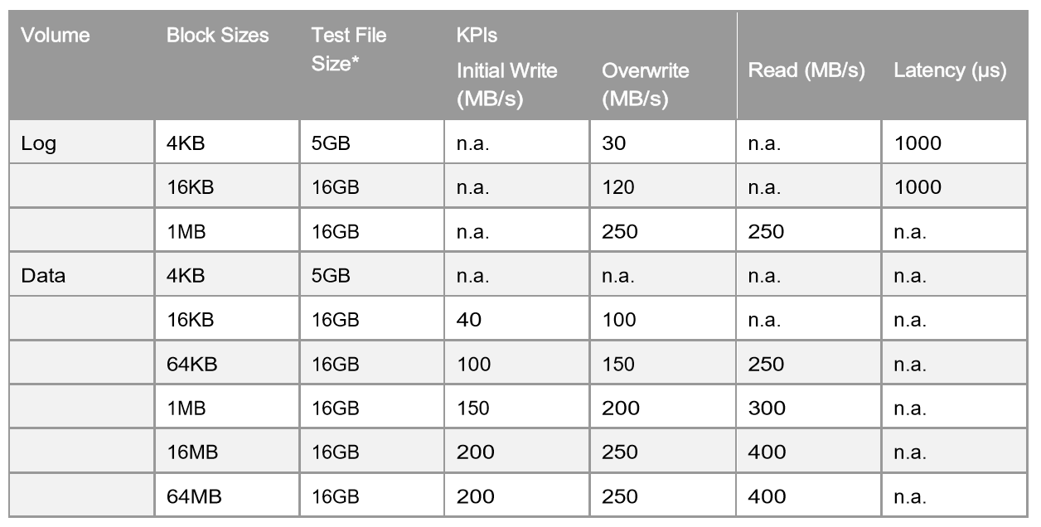
SAP HANA Hardware Configuration Check Tool (HWCCT) – KPIs for Storage (Production)
Source SAP Note: 1943937 - Hardware Configuration Check Tool - Central Note
Notes:
The HWCCT is a tool to verify that is the HANA system configuration – OS, network and storage meets the minimum performance criteria required to run SAP HANA in production.

Slide 52
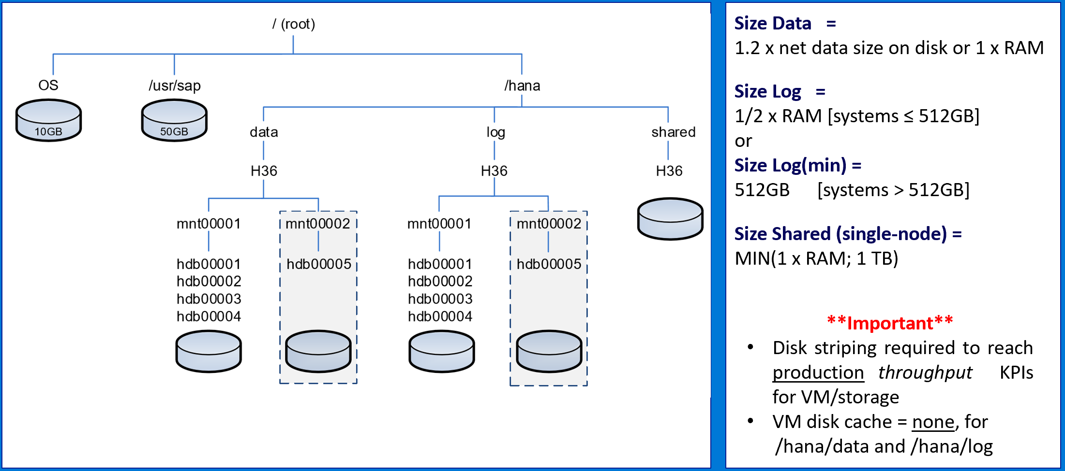
SAP HANA Storage Layout (TDI Best Practice)
Source SAP - SAP HANA Storage Requirements
Notes:
Best practice for sizing persistence (storage) for SAP HANA.

Slide 53
Premium Storage KPIs & Cost
Premium Storage Disk Type | P4 | P6 | P10 | P15 | P20 | P30 | P40 | P50
Disk size | 32 GB | 64 GB | 128 GB | 256 GB | 512 GB | 1024 GB (1 TB) | 2048 GB (2 TB) | 4096 GB (4 TB)
IOPS per disk | 120 | 240 | 500 | 1100 | 2,300 | 5,000 | 7,500 | 7,500
Throughput per disk | 25 MB/s | 50 MB/s | 100 MB/s | 125 MB/s | 150 MB/s | 200 MB/s | 250 MB/s | 250 MB/s
Storage Cost | $ 4.80 /month | $ 9.28 /month | $ 17.92 /month | $ 38.02 /month | $ 66.56 /month | $ 122.88 /month | $ 235.52 /month | $ 450.56 /month
Stripe (i.e. LVM) Premium Storage Managed Disks to concatenate throughput and satisfy HANA TDI/HWCCT Storage KPI’s requirements for /hana/data and hana/log
Notes:
Refer to the current slide when considering Azure VM based deployments of HANA on Azure – for both production and non-production workloads. As you can see on the current slide these options include DS series VMs – namely DS14_v2 and DS15_v2 – as well as GS series VMs, namely GS4 and GS5. Across these 4 VM sizes, we can implement systems supporting between 24,180 and 41,670 SAPS. The first three VM sizes are intended for non-production workloads, while the last one allows us to deploy SAP Business Warehouse on HANA, HANA Online Analytical Processing, and S/4HANA, with database of up to about half a TB in size. The size limit is imposed by the amount of memory available in GS5 – equal to 448 GB.
HANA database and logs must reside on Premium Storage disks. This gives us effectively three choices of disk sizes – represented by the premium storage disk types – P10, P20, P30. Each size corresponds to specific number of IOPS per disk and throughput per disk. In particular, P10 gives us 128GB of storage with 500 IOPS and 100MB/sec throughput, P20 offers 512GB of storage with 2,300 IOPS and 150MB/s, and with P30, you get 1TB of storage with 5000 IOPS and 200 MBPs. If you need to further increase these values, in terms of storage space, IOPS, or throughput, you can create multi-disk volumes by using either MDADM or logical volume manager.

Slide 54
Downtime Minimized Migration (DMO/SUM) to Azure/HANA
DMO with System Move
– change PAS host during DMO
Source SAP: DMO/SUM 1.0 SP21 Guide (source PAS must be UNIX/LINUX based)
Notes:
Downtime minimized migration to HANA via DMO/SUM – system move. Source primary application server (PAS) must be UNIX/LINUX based.

